Slide 1
The Mathematics of Star Trek Workshop
Lecture 3: Wavelets and Data Compression

Slide 2
Topics
Fourier Series
Wavelets
FBI Fingerprint Compression
A Wavelet-Based Data Compression Scheme
An Image Compression Example
Averaging and Differencing

Slide 3
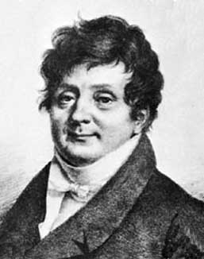
Fourier Series
A function f(x) is said to be periodic with period a if f(x+a)=f(x) for all x in the domain of f.
For a function f with period 2π, the Fourier series of f is a sum of the form:
a₀ + ∑_{n=1}¹ (a_{n} cos nx + b_{n} sin nx), where
  a₀ = 1/(2π) _{-π}^{π} f(x) dx,
  a_{n} = 1/π  _{-π}^{π} f(x) cos nx dx,
  b_{n} = 1/π  _{-π}^{π} f(x) sin nx dx.
Applications of Fourier series include solving partial differential equations and signal processing.
Joseph Fourier (1768-1830) used this idea of writing a function as a sum of trigonometric functions in his study of the mathematical theory of heat conduction.

Slide 4
Fourier Series (cont.)
For functions that are piecewise smooth, i.e. continuous and differentiable, except for a finite number of holes, jumps, or corners on any interval in the domain of f, the Fourier series of f will converge to f.
For example, to the right is a graph of the step function:
  f(x) = 0 for -π<x<0,
  f(x) = 1 for 0<x<π.
The first few terms of the step function’s Fourier series are shown to the right.

Slide 5
Wavelets
Similar to Fourier series, Wavelets are mathematical functions that are used to represent data or other functions, by analyzing the data according to scale.
Wavelets were developed independently in the fields of mathematics, quantum physics, electrical engineering, and seismic geology.
Applications of wavelets include:
  Astronomy
  Acoustics
  Nuclear engineering
More applications of wavelets:
  Signal and image processing
  Neurophysiology
  Music
  Magnetic resonance imaging
  Speech discrimination
  Optics
  Earthquake-prediction,
  Radar
  Human vision
  Solving partial differential equations

Slide 6
A Use of Wavelets: FBI Fingerprint Compression
Since 1924, the US Federal Bureau of Investigation has collected over 200 million sets of fingerprints.
Most fingerprint files are inked impressions on paper cards.
Low-quality faxes of the impressions are sent out to law enforcement agencies.
Various jurisdictions have been experimenting with digital storage of the prints, causing incompatibilities between data storage formats.
To address this problem, the FBI's Criminal Justice Information Services Division, along with the National Institute of Standards and Technology (NIST), Los Alamos National Laboratory, commercial vendors, and criminal justice communities have developed standards for fingerprint digitization and compression.

Slide 7
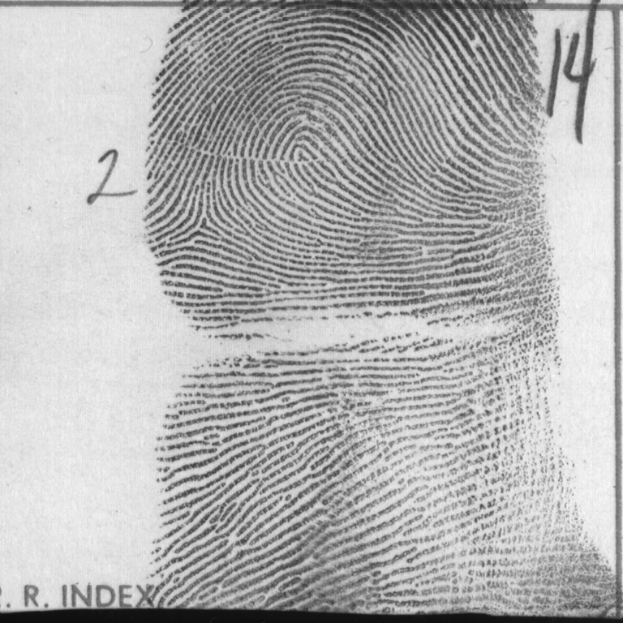
A Use of Wavelets: FBI Fingerprint Compression (cont.)
Here’s an image of a fingerprint which is made up of an array of size 768 x 768 = 589,824 numbers known as pixels.
Each pixel is a number that represents a gray level ranging from black (minimum number) to white (maximum number).
This image uses 256 = 2⁸ levels of gray for each pixel.
Thus, each pixel uses one byte of storage space on a computer and 589,824 bytes (~0.6 MB) are required to store the entire fingerprint.
A pair of hands would require about 6 MB of storage!

Slide 8
A Use of Wavelets: FBI Fingerprint Compression (cont.)
Since large amounts of data are needed to represent fingerprints in this way, it would be useful to find a way to use less data to describe the fingerprint.
In the mid 1990’s, digitizing the FBI's archive would have resulted in about 2000 terabytes of data!
Recall that 1 terabyte is 2¹⁰ = 1024 gigabytes.
Thus, at a cost of about $900 per gigabyte, the cost of storing these uncompressed images would be about 200 million dollars!
Note that this cost estimate is based on data storage capacities and costs in the mid 1990’s – how would this compare to data storage capacities and costs today?

Slide 9
A Use of Wavelets: FBI Fingerprint Compression (cont.)
Clearly, data compression would help with reducing the cost of data storage.
Common compression standards such as JPEG (Joint Photographic Experts Group) format reduce the amount of data required, but do not provide enough detail upon recovery of the image after compression. (See the next slide - notice the blocking that occurs in the recovered image.)
One way to compress data and be able to recover sufficient detail to be useful is via wavelets. (See the slide after the next slide.)

Slide 10
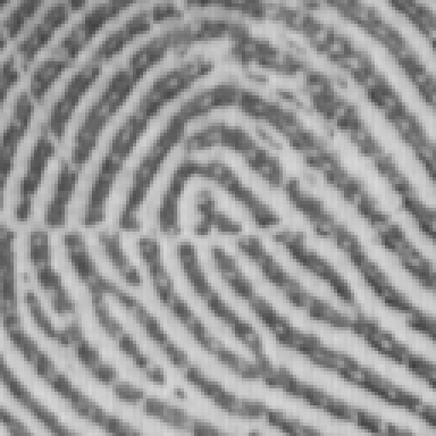
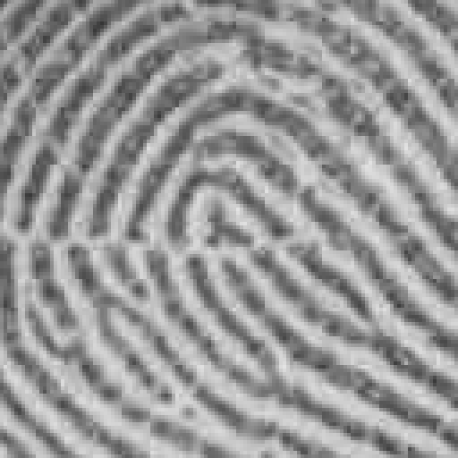
A Use of Wavelets: FBI Fingerprint Compression (cont.)
Original Image
12.9:1 JPEG Compression

Slide 11
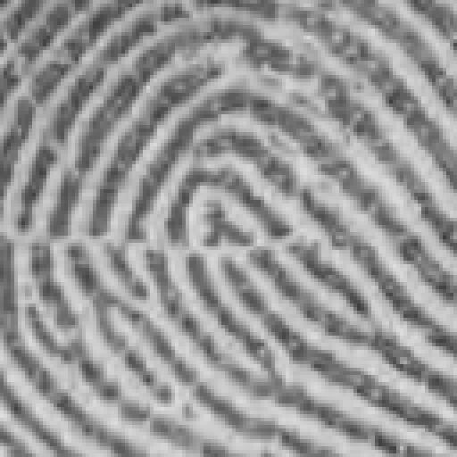
A Use of Wavelets: FBI Fingerprint Compression (cont.)
Original Image
12.9:1 Wavelet Compression

Slide 12
A Wavelet-Based Data Compression Scheme
We now illustrate one way to compress data that is essentially what is being done with wavelet compression!
Consider the following string of eight pieces of data, which could be data from a function or data from an 8 x 8 pixel image:
64 48 16 32 56 56 48 24.
By performing a process known as averaging and differencing (we’ll see how this is done later), this data is transformed into a new set of data made up of one average (in italics) and seven detail coefficients (in bold):
43 -3 16 10 8 -8 0 12.
This process can be reversed to recover the original data!
Note that for this example there are six non-zero detail coefficients.
A transformation of data of this type is known as lossless compression, since no information is lost.

Slide 13
A Wavelet-Based Data Compression Scheme (cont.)
If we replace the -3 detail coefficient with 0 and reverse the averaging and differencing process, we will get an approximation to our original data, using five non-zero detail coefficients (instead of six):
67 51 19 35 53 53 45 21.
If we also replace the -8 and 8 detail coefficients with 0, we will get an approximation to our original data, using only three non-zero detail coefficients:
59 59 27 27 53 53 45 21.

Slide 14
A Wavelet-Based Data Compression Scheme (cont.)
When detail coefficients are replaced with zeros, we are performing lossy compression at a threshold level , where any coefficient whose magnitude is less than  is set to zero.
Thus, replacing –3, -8, and 8 with a zero corresponds to lossy compression at a threshold level of 8.

Slide 15
A Wavelet-Based Data Compression Scheme (cont.)
Here are graphs of the original data (black curves) and the approximations (red curves) to the original data:

Slide 16
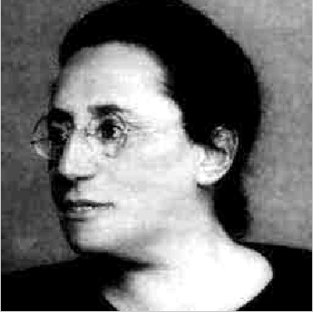
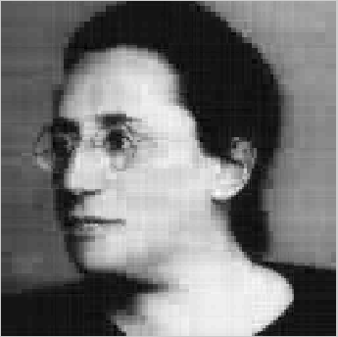
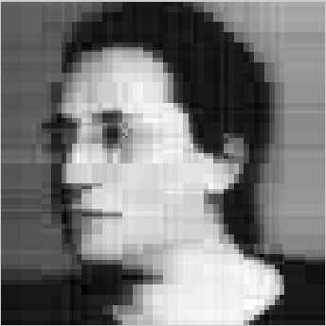
A Wavelet-Based Data Compression Scheme (cont.)
Since picture data is just a string of numbers describing gray levels, the idea of lossy compression can be used to reduce the amount of information needed to be stored for a picture!
Below, from left to right, are the original picture of Emmy Noether, along with pictures that have been compressed using 4% and 1% of the detail coefficients!

Slide 17
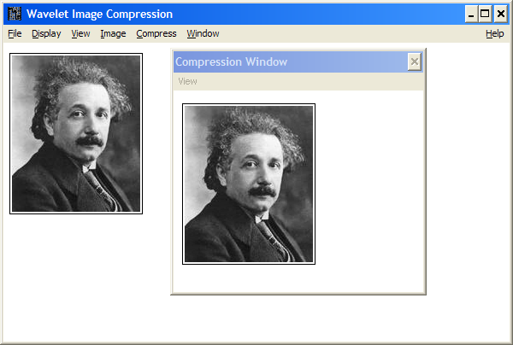
Compressing an Image!
Using the software Wavcomp, we can actually compress images!
Try this with Albert Einstein's picture!
Directions follow on how to do this from any lab computer on campus.

Slide 18
An Image Compression Example (cont.)
On the web page http://faculty.gvsu.edu/aboufade/web/wavelets/software.htm, click on the Wavcomp link to download the file wavcomp.zip.
Extract the contents of this folder to the Windows Desktop.
Click on the File menu and choose Open Picture.
Double click on one of the *.isc files. For example, choosing fprintx1.isc will select a picture of a fingerprint.
Click on the Compress menu and choose Start Compression. A new window will appear. Choose OK.
A new window will appear with a number (often it will be 1.125) in a box labeled Threshold Level. Type in a number greater than or equal to zero. Then choose OK.
A new box will appear that tells how many data coefficients have been discarded and the total number of data in the original image. Click OK.
Expand the compression window and compare the original image to the new image!
Note: This software is for 32-bit Windows machines.

Slide 19
Averaging and Differencing
We now look at how to apply the averaging and differencing scheme for data compression!
Given a row of 2^{n} values of data, such as
64 48 16 32 56 56 48 24
(in this case n = 3), create n new rows of data as follows:
First, find the average of successive pairs:
(64+48)/2 = 112/2 = 56,
(16+32)/2 = 48/2 = 24,
(56+56)/2 = 112/2 = 56,
(48+24)/2 = 72/2 = 36.
Write these four averages in a second row below the first row of data, in order:

Slide 20
Averaging and Differencing (cont.)
Row 1: 64 48 16 32 56 56 48 24
Row 2: 56 24 56 36
Next compute the difference between the first element of a pair in Row 1 and the corresponding average in Row 2.
64 - 56 = 8,
16 - 24 = -8,
56 - 56 = 0,
48 - 36 = 12.

Slide 21
Averaging and Differencing (cont.)
These differences fill out the remaining four entries of Row 2, in order.
Thus we have:
Row 1: 64 48 16 32 56 56 48 24
Row 2: 56 24 56 36 8 -8 0 12

Slide 22
Averaging and Differencing (cont.)
For the next row, Row 3, apply averaging and differencing to the first four entries of Row 2.
The last four entries are the same as the last four entries of Row 2:
Row 1: 64 48 16 32 56 56 48 24
Row 2: 56 24 56 36 8 -8 0 12
Row 3: 40 46 16 10 8 -8 0 12

Slide 23
Averaging and Differencing (cont.)
Row 4 is obtained by applying averaging and differencing to the first pair of numbers in Row 3 and reproducing the remaining entries from Row 3:
Row 1: 64 48 16 32 56 56 48 24
Row 2: 56 24 56 36 8 -8 0 12
Row 3: 40 46 16 10 8 -8 0 12
Row 4: 43 -3 16 10 8 -8 0 12
Note that the first entry in Row 4, namely 43, is the average of all eight numbers in Row 1! (HW - check why this is true.)

Slide 24
References
The wavelet introduction and FBI example come from the paper “An Introduction to Wavelets” by Amara Graps (IEEE Computational Science and Engineering, Summer 1995, vol. 2, no. 2, http://web.archive.org/web/20121226011210/http://www.amara.com/IEEEwave/IEEEwavelet.html and Chris Brislawn’s paper: http://www.ams.org/notices/199511/brislawn.pdf.
The examples of data compression and the pictures of Emmy Noether are from the paper “Plotting & Scheming With Wavelets” by Colm Mulcahy (Mathematics Magazine, Vol 69, No 5, December 1996, 323-343, which can be found here: http://www5.spelman.edu/~colm/wav.html.
“Wavcomp”, written by Mochan Shrestha a student at Grand Valley State University can be downloaded from: http://faculty.gvsu.edu/aboufade/web/wavelets/software.htm.
The brief introduction to Fourier series is from Boundary Value Problems, 5th edition, by David Powers, 2006.

