Slide 1
The Mathematics of Star Trek Workshop
Lecture 1: Red Shirt Survivability

Slide 2
Red Shirts in Star Trek TOS
Two terms that have entered popular culture are “red shirt” and “expendable crewmember.”
In Star Trek TOS, often the crew member(s) wearing a red shirt as part of their uniform die soon after being introduced.
A natural question to ask is – what is the likelihood of dying in the Star Trek Universe if one’s uniform is red?

Slide 3
Outline
Basic Probability Concepts
Star Trek TOS Data
Conditional Probability
Answer the Question!

Slide 4
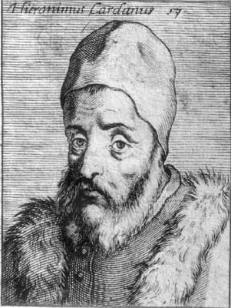
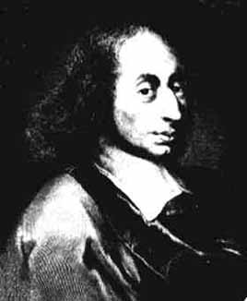
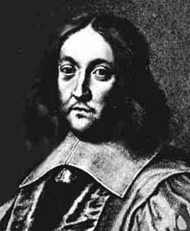
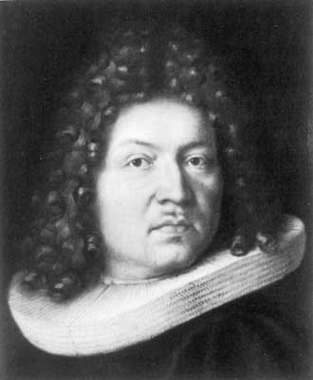
Basic Probability Concepts
Formally, the study of probability began with the posthumous publication of Girolamo Cardano’s “Book on Games and Chance” in 1663.
Probably he wrote it in ~1563.
Other “key” players in the development of this branch of mathematics include:
Blaise Pascal and Pierre de Fermat (17th century).
Jakob Bernoulli (late 17th century).

Slide 5
Definition of Probability
One way to define probability is as follows:
The probability of an event E is a quantified assessment of the likelihood of E.
By quantified, we mean a number is assigned.
In order to understand this definition, we need some more definitions and concepts!

Slide 6
More Definitions!
Each time we consider a probability problem, we think of it as an experiment, either real or imagined.
An experiment is a test or trial of something that is repeatable.
The first step in such a problem is to consider the sample space.
The sample space S of an experiment is a set whose elements are all the possible outcomes of the experiment.

Slide 7
Example 1: Some Experiments and Sample Spaces
1(a)
Experiment: Select a card from a deck of 52 cards.
Sample Space: S = {A♦, A♥, A♠, A♣, 2♦, 2♥, 2♠, 2♣ …, K♦, K♥, K♠, K♣}
1(b)
Experiment: Poll a group of voters on their choice in an election with three candidates, A, B, and C.
Sample Space: S = { A, B, C}.

Slide 8
Example 1: Some Experiments and Sample Spaces (cont.)
1(c)
Experiment: Flip a coin, observe the up face.
Sample Space: S = {H, T}
1(d)
Experiment: Roll two six-sided dice, observe up faces.
Sample Space: S = {(1,1), (1,2), (1,3), (1,4), (1,5), (1,6), …, (6,1), (6,2), (6,3), (6,4), (6,5), (6,6)}

Slide 9
Another Definition!
When working with probability, we also need to define event.
An event E is any subset of the sample space S. An event consists of any number of outcomes in the sample space.
Notation: E  S.

Slide 10
Example 2: Some Events
2(a)
Experiment: Select a card from a deck of 52 cards.
Sample Space: S = {A♦, A♥, A♠, A♣, 2♦, 2♥, 2♠, 2♣ …, K♦, K♥, K♠, K♣}
Event: Select a card with a diamond. E = {A♦, 2♦, …, K♦}

Slide 11
Example 2: Some Events (cont.)
2(b)
Experiment: Poll a group of voters on their choice in an election with three candidates, A, B, and C.
Sample Space: S = { A, B, C}
Event: Voter chooses B or C. E = {B,C}.

Slide 12
Example 2: Some Events (cont.)
2(c)
Experiment: Flip a coin, observe the up face.
Sample Space: S = {H, T}
Event: Up face is Tail. E = {T}.

Slide 13
Example 2: Some Events (cont.)
2(d)
Experiment: Roll two six-sided dice, observe up faces.
Sample Space: S = {(1,1), (1,2), (1,3), (1,4), (1,5), (1,6), …, (6,1), (6,2), (6,3), (6,4), (6,5), (6,6)}
Event: Roll a pair: E = {(1,1}, (2,2), (3,3), (4,4), (5,5), (6,6)}

Slide 14
Example 2: Some Events (cont.)
2(e)
Experiment: Roll two six-sided dice, add the up faces.
Sample Space: S = {2, 3, 4, 5, 6, 7, 8, 9, 10, 11, 12}
Event: Roll an odd sum: E = {3, 5, 7, 9, 11}

Slide 15
Probability of an Event
With these definitions, we can now define how to compute the probability of an event!

Slide 16
How to find the Probability of an Event E
Determine the elements of the sample space S.
S = {s₁, s₂, …, s_{n}}.
Assign a weight or probability (i.e. number) to each element of S in such a way that:
Each weight is at least 0 and at most 1.
The sum of all the weights is 1.
(For each element s_{i} in S, denote its weight by p(s_{i}).)
Add the weights of all outcomes contained in event E.
The sum of the weights of E is the probability of E and is denoted p(E).

Slide 17
How to find the Probability of an Event E (cont.)
Notes:
Weights may be assigned in any fashion in Step 2, as long as both conditions are met.
Usually we choose weights that make sense in reality.
A probability model is a sample space S together with probabilities for each element of S.
If each element of sample space S has the same probability, the model is said to have equally likely outcomes.

Slide 18
Example 3: Some Probability Models
3(a)
Experiment: Select a card from a deck of 52 cards.
Sample Space: S = {A♦, A♥, A♠, A♣, 2♦, 2♥, 2♠, 2♣ …, K♦, K♥, K♠, K♣}
p(A♦) = p(A♥) = … = p(K♠) = p(K♣) = 1/52
For the event “select a card with a diamond”,
E = {A♦, 2♦, …, K♦} and
p(E) = p(A♦) + p(2♦) + … + p(K♦) = 13/52 = 1/4.

Slide 19
Example 3: Some Probability Models (cont.)
3(b)
Experiment: Poll a group of voters on their choice in an election with three candidates, A, B, and C.
Sample Space: S = { A, B, C}
p(A) = 0.42; p(B) = 0.15; p(C) = 0.43.
For the event “a voter chooses B or C”,
E = {B,C} and
p(E) = p(B) + p(C) = 0.15 + 0.43 = 0.58.

Slide 20
Example 3: Some Probability Models (cont.)
3(c)
Experiment: Flip a coin, observe the up face.
Sample Space: S = {H, T}
p(H) = 1/2; p(T) = 1/2
For the event “the up face is Tail”,
E = {T} and
p(E) = 1/2.

Slide 21
Example 3: Some Probability Models (cont.)
3(d)
Experiment: Roll two six-sided dice, observe up faces.
Sample Space: S = {(1,1), (1,2), (1,3), (1,4), (1,5), (1,6), …, (6,1), (6,2), (6,3), (6,4), (6,5), (6,6)}
p((i,j)) = 1/36 for each i = 1,2, …, 6; j = 1, 2, …, 6.
For the event “roll a pair”,
E = {(1,1}, (2,2), (3,3), (4,4), (5,5), (6,6)}, so
p(E) = 1/36 + 1/36 + …+1/36 = 6/36 = 1/6.

Slide 22
Example 3: Some Probability Models (cont.)
3(e)
Experiment: Roll two six-sided dice, add the up faces.
Sample Space: S = {different possible sums} = {2, 3, 4, 5, 6, 7, 8, 9, 10, 11, 12}
Using the probability model for example 3 (d), we find
p(2) = 1/36; p(3) = 2/36; p(4) = 3/36; p(5) = 4/36; p(6) = 5/36; p(7) = 6/36; p(8) = 5/36; p(9) = 4/36; p(10) = 3/36; p(11) = 2/36; p(12) = 1/36.
For the event “roll an odd sum”,
E = {3, 5, 7, 9, 11} and
p(E) = p(3) + p(5) + p(7) + p(9) + p(11)
= 2/36 + 4/36 + 6/36 + 4/36 + 2/36 = 18/36 = 1/2.

Slide 23
Remark on Probability Models with Equally Likely Outcomes
Examples 3(a), 3(c), and 3(d) are probability models with equally likely outcomes.
Notice that in each case,
p(E) = (# elements in E)/(# elements in S).
This is true in general for probability models with equally likely outcomes!
Notice that this property fails for examples 3(b) and 3(e).
For example, in 3(e), # elements in E = 5 and # elements in S = 11, but p(E) = 1/2.

Slide 24
Back to the Star Trek Universe!
Now we are ready to look at some Star Trek Examples!
Of the 43 on-screen deaths in TOS, 10 were gold shirts, 8 were blue shirts, and 25 were red shirts.

Slide 25
Example 4
Assuming all on-screen deaths are equally likely, what would be the probability that a crew member who died has a red shirt?
Solution:
S = {crew members that died}
E = {red shirt}
P(E) = (# E)/(# S) = 25/43 = 58.1%

Slide 26
Example 4 (cont.)
Similarly, we find that the probabilities that a crew member who died onscreen is wearing a gold shirt or blue shirt are:
10/43 = 23.3% and 8/43 = 18.6%, respectively.

Slide 27
Conditional Probability
So, have we answered the question: “What is the likelihood of dying if a crew member’s shirt is red?”
No – actually, in Example 4 we have answered the question: “What is the likelihood of a crew member’s shirt being red if the crew member dies?”
The answer to each of these questions involves the idea of conditional probability.

Slide 28
Conditional Probability
Suppose for some experiment we are interested only in those outcomes that are elements of a subset of the sample space.
Then we can think of the subset as our sample space and use the ideas above to find probabilities of events from this subset!
We can think of the last example in these terms …

Slide 29
Conditional Probability
Assume all crew members of the Starship Enterprise have an equal chance of being chosen.
Think of the crew members who die as a subset of the entire crew.
Let A = {red shirts} and B = {crew members who die}.
From Example 4, the probability that a crew member who dies has a red shirt is
(# red shirts who die)/(# crew members who die)
= (# in A and B)/(# in B) = 25/43
If we divide both numerator and denominator by the total number of crew members, then we can write this last ratio as
25/43 = (25/430)/(43/430)
=((# in A and B)/total # crew)/ ((# in B)/(total # crew))
=P(A ∩ B)/P(B)
Starship Enterprise Crew Data
Uniform Color | Known Fatalities | Total Population
Gold | 10 | 55
Blue | 8 | 136
Red | 25 | 239
Total | 43 | 430

Slide 30
Conditional Probability
Examples like this last one are the basis for the following definition.
The conditional probability of an event A given that event B has occurred is defined by P(A|B) = P(A ∩ B)/P(B).
Note that P(B) > 0 for this definition to make sense.

Slide 31
Finally – the Answer!
Now we are ready to answer the question “What is the likelihood of dying if a crew member’s shirt is red?”
i.e. “What is the probability that a crew member dies given that the crew member is wearing a red shirt?”
Let A = {crew members who die} and B = {red shirts}.
What we want to find is the conditional probability P(A|B).
P(A|B)
= P(A ∩ B)/P(B)
= (25/430)/(239/430)
= 25/239
= 10.5%
Note that this is also (# red shirt deaths)/(# red shirts)
Starship Enterprise Crew Data
Uniform Color | Known Fatalities | Total Population
Gold | 10 | 55
Blue | 8 | 136
Red | 25 | 239
Total | 43 | 430

Slide 32
The “Safest” Shirt Color!
Similarly, one finds that the probability that a crew member with a gold shirt dies is 18.2%, and the probability that a crew member with a blue shirt dies is 5.9%.
Thus, the least safe shirt color is actually GOLD!!
Starship Enterprise Crew Data
Uniform Color | Known Fatalities | Total Population
Gold | 10 | 55
Blue | 8 | 136
Red | 25 | 239
Total | 43 | 430

Slide 33
References
For All Practical Purposes (5th ed.) by COMAP
The Cartoon Guide to Statistics by Gonick and Smith
Probability and Statistical Inference (5th ed.) by Hogg and Tanis
http://aperiodical.com/2013/04/the-maths-of-star-trek-the-original-series-part-i/

